Slide 1

5
CYBER MOVES
THIS WEEK
One action per day. No tech skills required. Takes under 10 minutes total.
rexcalloway.com
Notes:
[Sources]
- User-provided source deck; copy and claims preserved without independent verification in this formatting pass.
- AI-generated hero background created with OpenAI image generation; prompt embedded in image metadata.

Slide 2
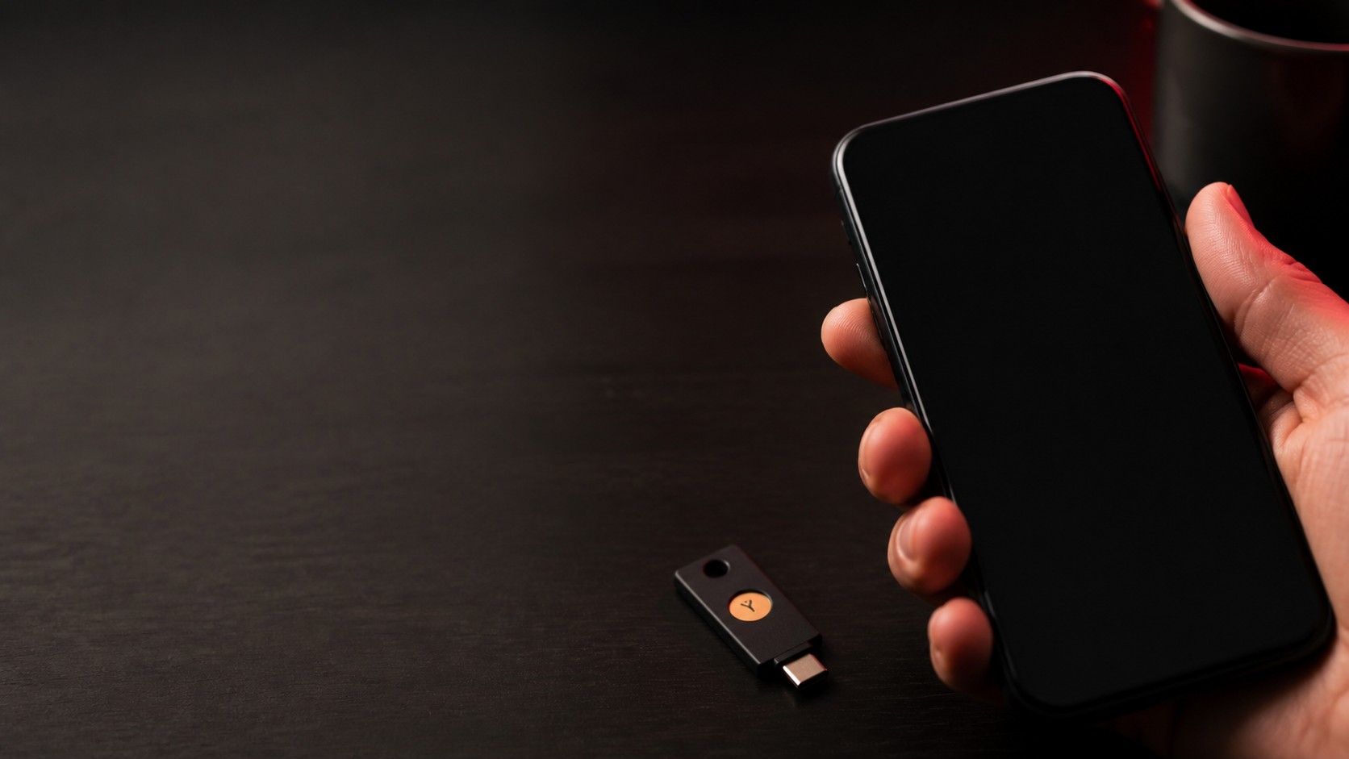
MOVE 01 / 05
01
YOUR MASTER KEY NEEDS A DEADBOLT
83%
Enable 2FA on Your Email
Your email resets every other account. If someone gets in, they own your bank, your social media, and every other account you have.
of account takeovers
are stopped by 2FA
✓
App (not SMS) for 2FA
WHAT TO DO
✓
Unique password per site
Go to your email settings → Security → Turn on 2-step verification. Use an app like Authy, not SMS.
✓
Auto-updates on
✓
Breached? Change it now
Notes:
[Sources]
- User-provided source deck; copy and claims preserved without independent verification in this formatting pass.
- AI-generated hero background created with OpenAI image generation; prompt embedded in image metadata.

Slide 3

MOVE 02 / 05
02
YOUR EMAIL HAS PROBABLY BEEN BREACHED
15B+
Check haveibeenpwned.com
On average, an email address appears in 4+ data breaches. Most people have no idea. You need to know.
accounts exposed
in known breaches
✓
App (not SMS) for 2FA
WHAT TO DO
✓
Unique password per site
Go to haveibeenpwned.com — type in your email. Change passwords for every service that appears.
✓
Auto-updates on
✓
Breached? Change it now
Notes:
[Sources]
- User-provided source deck; copy and claims preserved without independent verification in this formatting pass.
- AI-generated hero background created with OpenAI image generation; prompt embedded in image metadata.

Slide 4

MOVE 03 / 05
03
STOP REUSING THE SAME PASSWORD
65%
Install a Password Manager
One breached site hands attackers a key that works everywhere you reused that password. It's the most common attack pattern.
of people reuse
passwords across sites
✓
App (not SMS) for 2FA
WHAT TO DO
✓
Unique password per site
Download Bitwarden (free) or 1Password. Import your existing passwords. Let it generate new ones.
✓
Auto-updates on
✓
Breached? Change it now
Notes:
[Sources]
- User-provided source deck; copy and claims preserved without independent verification in this formatting pass.
- AI-generated hero background created with OpenAI image generation; prompt embedded in image metadata.

Slide 5
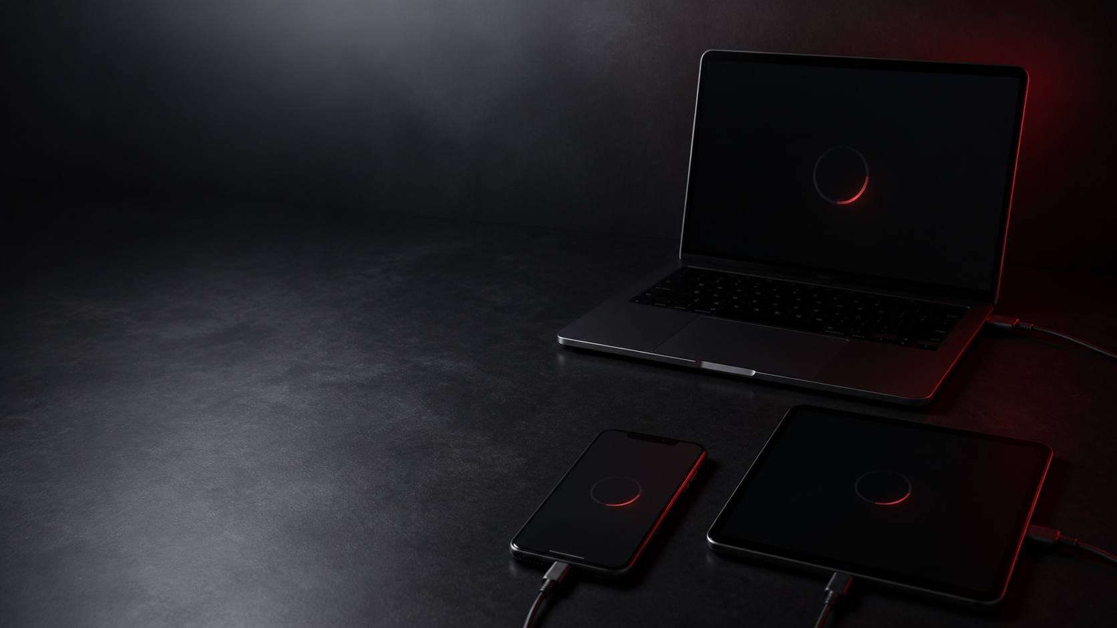
MOVE 04 / 05
04
ATTACKERS LOVE OUTDATED SOFTWARE
60%
Update All Your Devices
Most successful cyberattacks exploit vulnerabilities that patches already fixed months earlier. You're choosing to stay at risk.
of breaches exploit
known, patched flaws
✓
App (not SMS) for 2FA
WHAT TO DO
✓
Unique password per site
Check Settings → Software Update on your phone and computer. Enable automatic updates. Do it now.
✓
Auto-updates on
✓
Breached? Change it now
Notes:
[Sources]
- User-provided source deck; copy and claims preserved without independent verification in this formatting pass.
- AI-generated hero background created with OpenAI image generation; prompt embedded in image metadata.

Slide 6
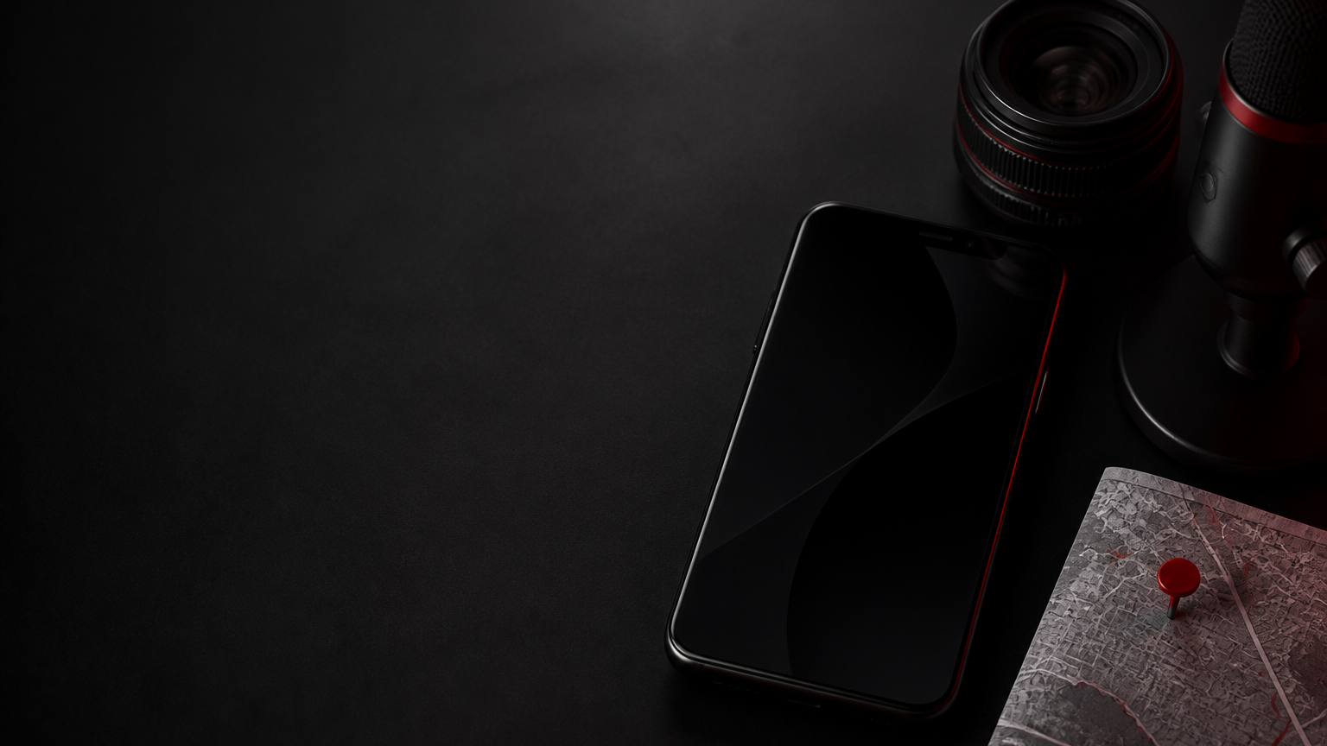
MOVE 05 / 05
05
APPS KNOW MORE THAN YOU THINK
avg 63
Review Your App Permissions
Apps collect your location, microphone access, contacts, and camera long after you stopped using them.
app permissions
granted per person
✓
App (not SMS) for 2FA
WHAT TO DO
✓
Unique password per site
Settings → Privacy → go through Location, Microphone, Camera, Contacts. Revoke anything that doesn't need it.
✓
Auto-updates on
✓
Breached? Change it now
Notes:
[Sources]
- User-provided source deck; copy and claims preserved without independent verification in this formatting pass.
- AI-generated hero background created with OpenAI image generation; prompt embedded in image metadata.

Slide 7

START
Start with one.
Do it today. Build from there.
01 Enable 2FA on email
04 Update all your devices
02 Check haveibeenpwned.com
05 Review app permissions
03 Install a password manager
Get the full Personal Security Bundle
→ rexcalloway.com/shop
Notes:
[Sources]
- User-provided source deck; copy and claims preserved without independent verification in this formatting pass.
- AI-generated hero background created with OpenAI image generation; prompt embedded in image metadata.

Slide 8

DISCLAIMER
Educational content only. Not financial, legal, tax, or professional cybersecurity advice. No professional-client relationship is created. Consult a qualified professional for your specific situation.
rexcalloway.com
Notes:
[Sources]
- User-provided source deck; copy and claims preserved without independent verification in this formatting pass.
- AI-generated hero background created with OpenAI image generation; prompt embedded in image metadata.

